Slide 1
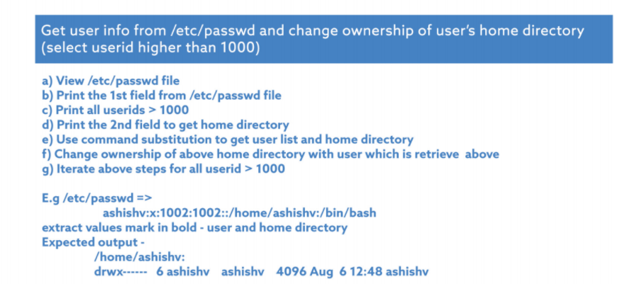
cat /etc/passwd
awk ‘{print $1}’ /etc/passwd
awk –F ’:’ ‘$3>1000 {print $3}’/etc/passwd

Slide 2
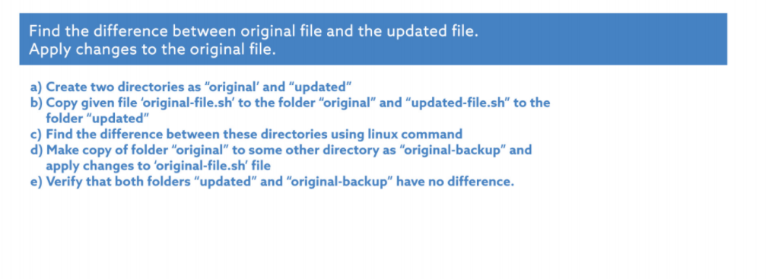
15 a) mkdir original updated
b)cp original-file.sh original/
Cp updated-file.sh updated/
c) diff original updated
d)(1)cp –r original original-backup
(2)cat updated/updated.file.sh > original-backup/original.file.sh
e) Diff updated original-backup

Slide 3
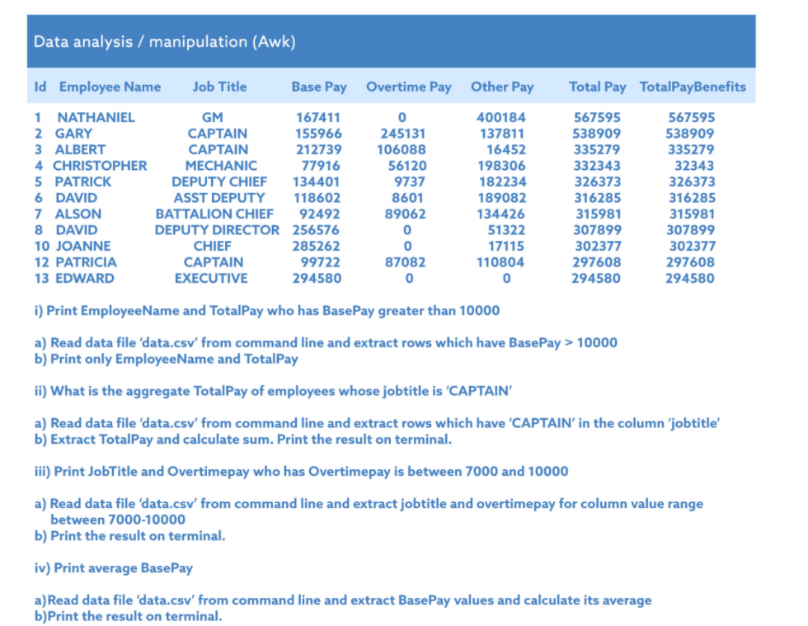
14 a)cat data.csv | awk ‘{if($4>10000) {print $2,$7}}’
b) cat data.csv | grep –i CAPTAIN | awk ‘{sum=sum+$7}’ END {print sum}’
c)cat data.csv | awk ‘{ if( $5>7000 && $5<10000){print $5,$3}}’
d)Cat data.csv | awk ‘{avg+=$4/13} END {print avg}’

Slide 4
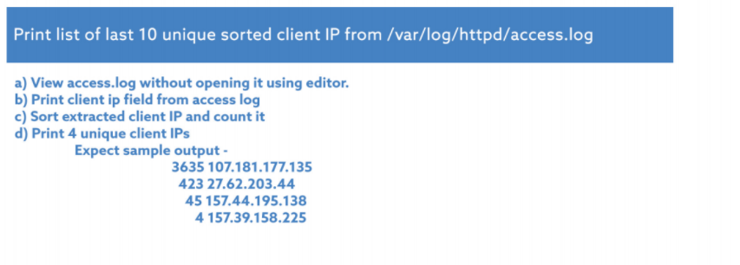
cat access.log
awk ‘{print $1}’ access.log
cat access.*| awk ‘{print $1}’ | sort | uniq –c |sort –n | wc –l
d) cat access.* | awk ‘{print $1}’ | sort | uniq –c | sort –n | head -4

Slide 5
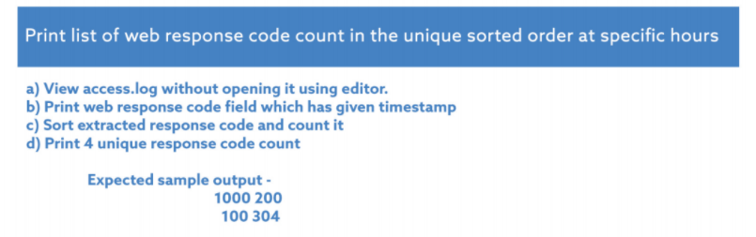
cat access.log
cat access.log | grep “\28\oct\2019:00” | awk ‘{ print $9}’
cat access.log | grep “\28\oct\2019:00” | awk ‘{ print $9}’ sort | uniq -c
cat access.log | awk ‘{ print $9 }’ | sort | uniq –c |head -4

Slide 6
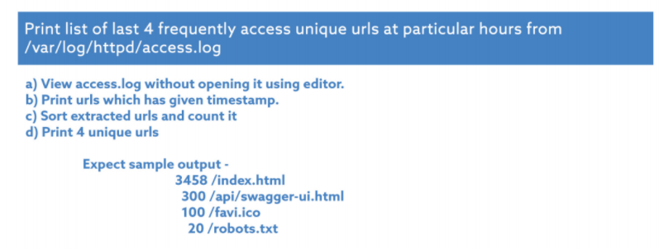
cat access.log
cat access.log | grep “\28\oct\2019:00” | awk ‘{ print $11}’
cat access.log | grep “\28\oct\2019:00” | awk ‘{ print $11}’ sort | uniq -c
cat access.log | awk ‘{ print $11 }’ | sort | uniq –c |head -4

Slide 7
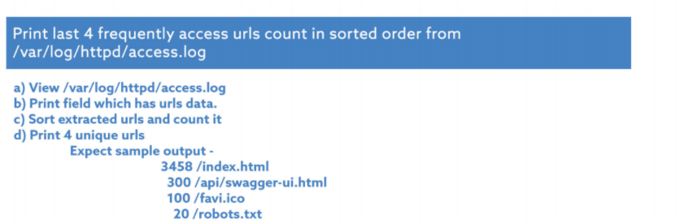
cat access.log
cat access.log | awk ‘{ print $11}’
cat access.log | awk ‘{ print $11}’ sort | uniq -c
cat access.log | awk ‘{ print $11 }’ | head -4

Slide 8
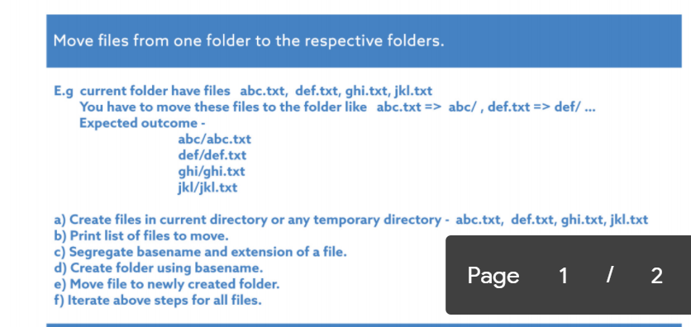
Touch abc.txt def.txt ghi.txt jkl.txt
ls
d) mkdir abc
e) mv abc.txt abc

Slide 9
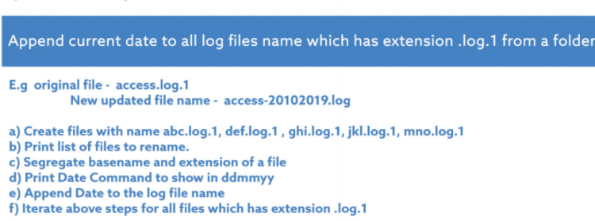
Touch abc.log.1 def.log.1 ghi.log.1 jkl.log.1 mno.log.1
ls
d) Print date %dd%mm%yy)
e)+date abc.log.1

Slide 10

a) find -mtime -7=archive b)mv archive backupfolder

Slide 11
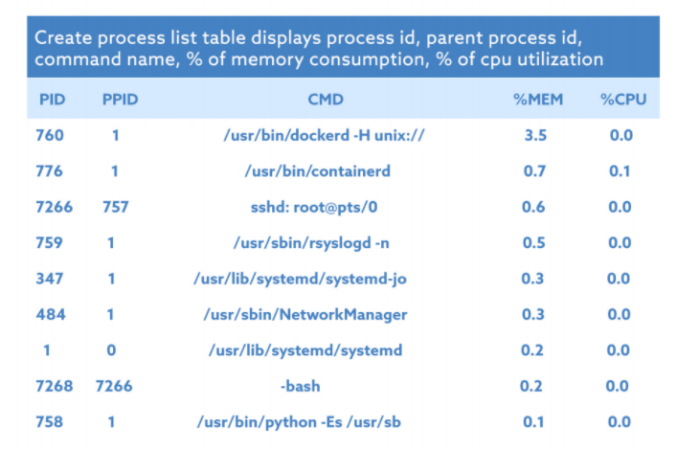
Ps pid,ppid,cmd,%mem,%cpu | awk ‘{print $0}’

